Slide 1
TRIALS & OMM
Matteo Monami
Diabetology and Metabolic Disease Unit
Careggi Teaching Hospital

Slide 2
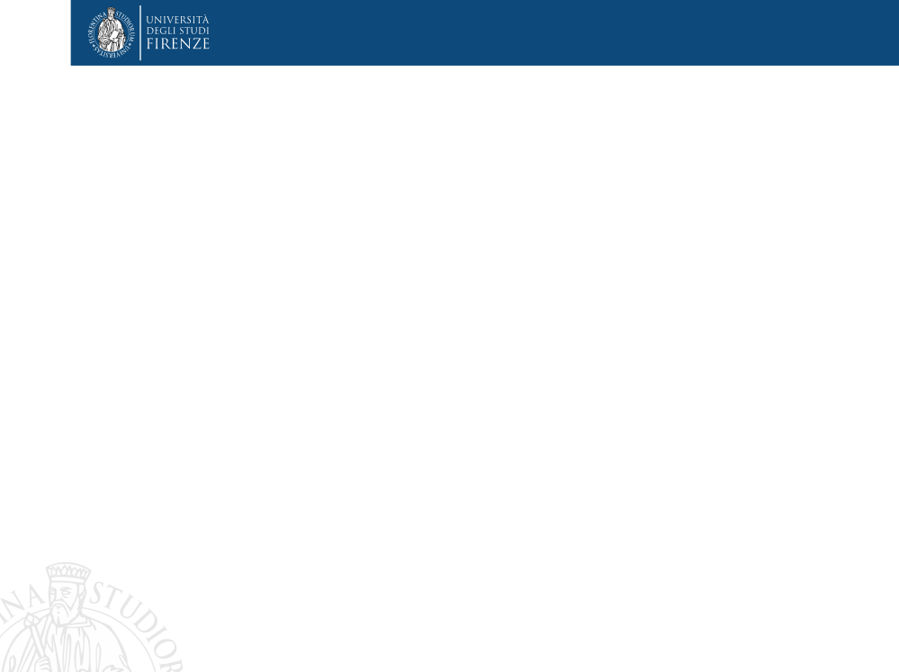
Il Dr. M. Monami ha ricevuto speaking fees/grant da:
Boehringer
Lilly
Novonordisk
Biocomposites
Molteni
e da Società Scientifiche:
SICOB
IFSO
EASO
SIO

Slide 3
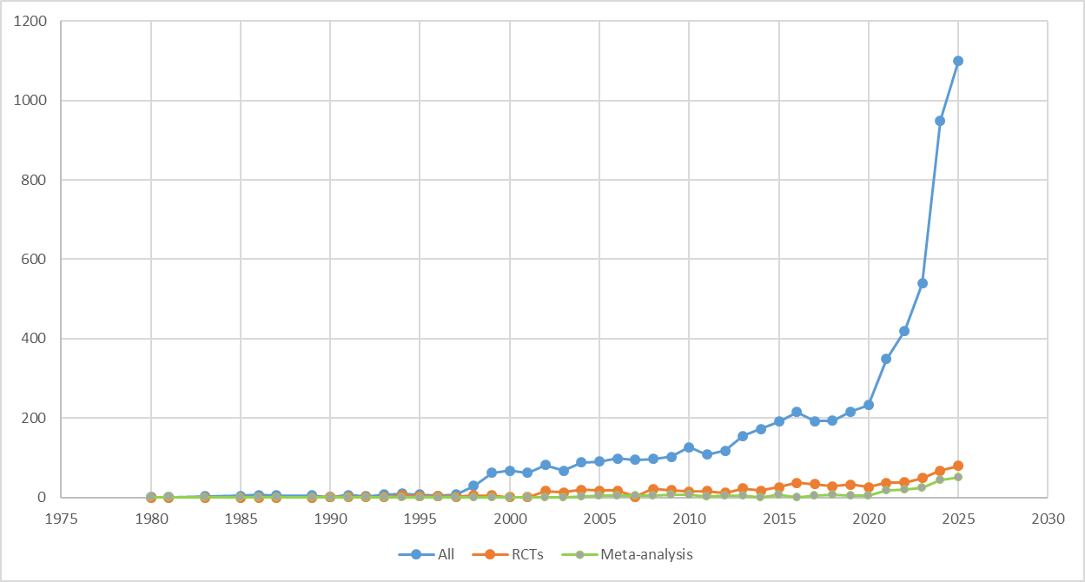
Search string: (obesity or overweight) AND (orlistat OR naltrexone OR bupropion OR liraglutide OR semaglutide OR tirzepatide OR phentermine/topiramate)

Slide 4
Search string: (obesity or overweight) AND (orlistat OR naltrexone OR bupropion OR liraglutide OR semaglutide OR tirzepatide OR phentermine/topiramate)
Trials on OMM: 768 up to 5th, May 2025

Slide 5
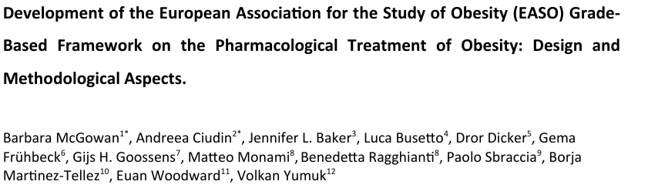
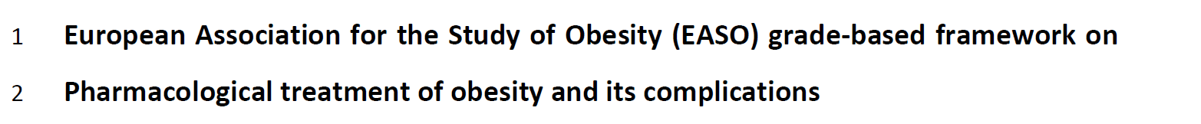
https://doi.org/10.1101/2025.04.07.25325370

Slide 6
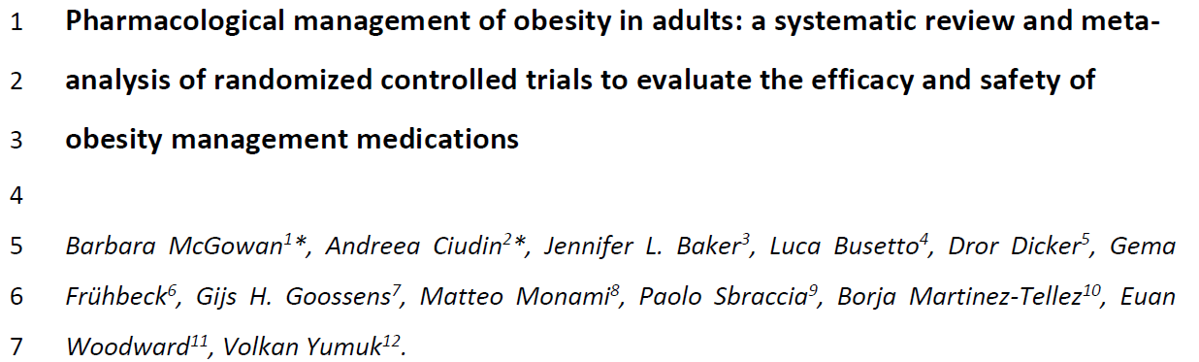

Slide 7
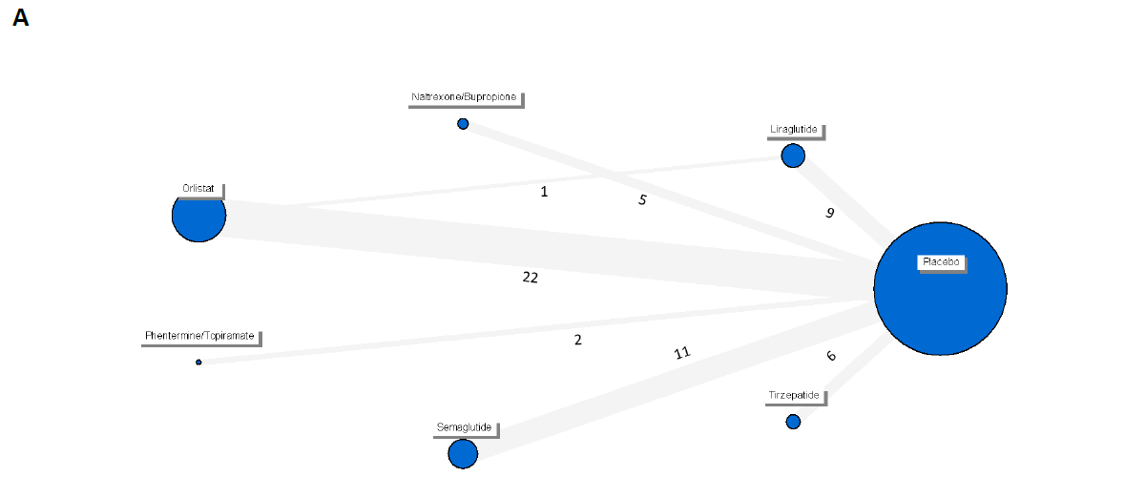
B
2 years
N= 22 trials
C
1 year
N= 58 trials
Search string: (obesity or overweight) AND (orlistat OR naltrexone OR bupropion OR liraglutide OR semaglutide OR tirzepatide OR phentermine/topiramate) up to 31st Jan, 2025. Treatment duration > 52±4 weeks.

Slide 8
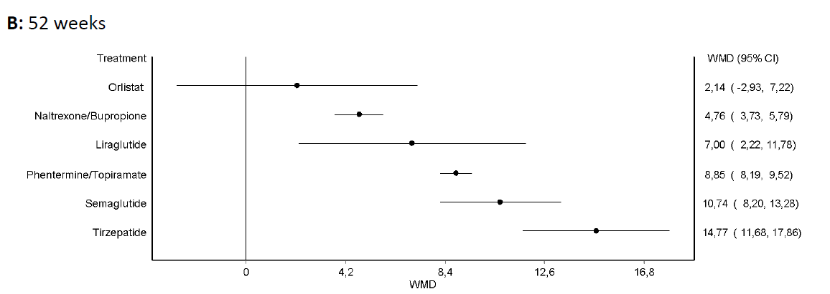

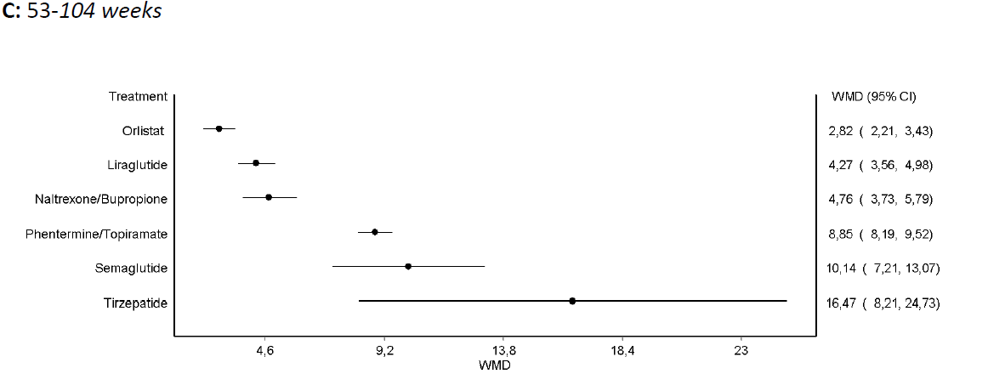

Slide 9
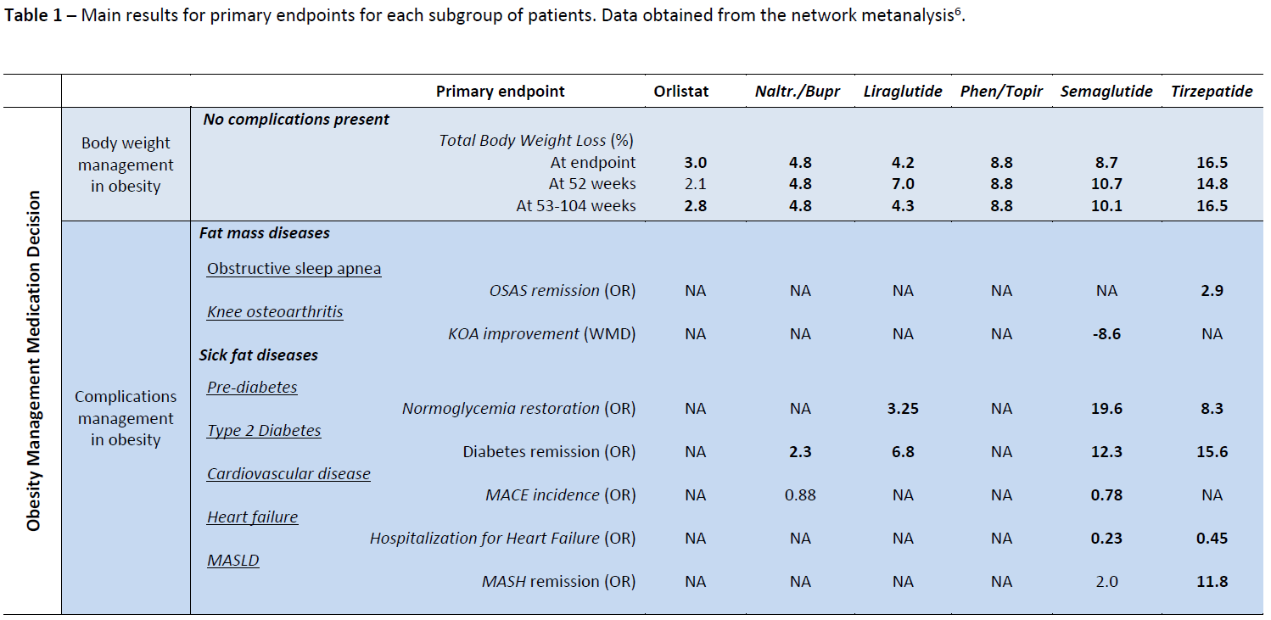

Slide 10
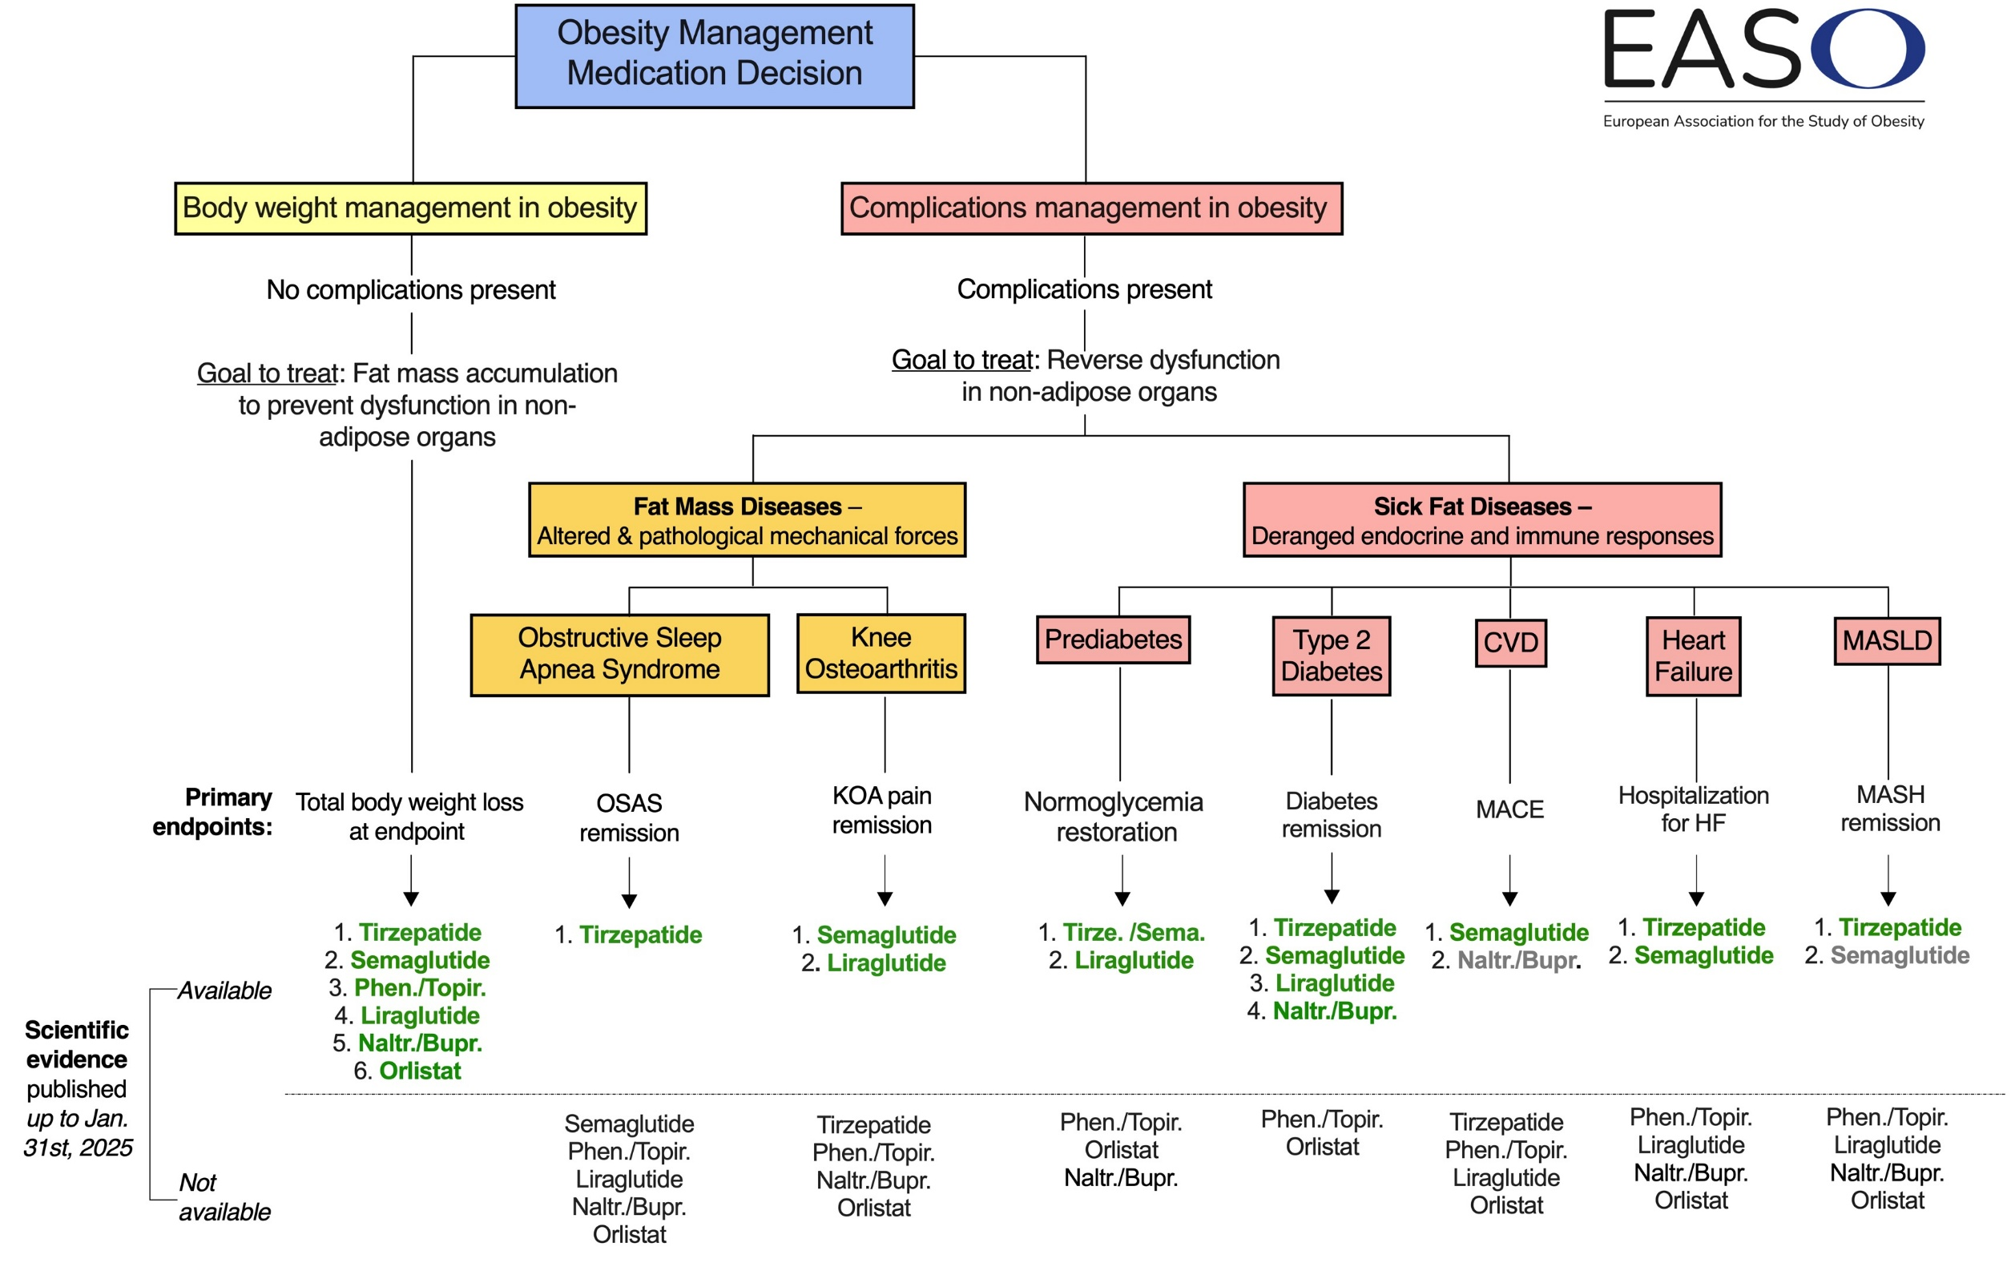

Slide 11
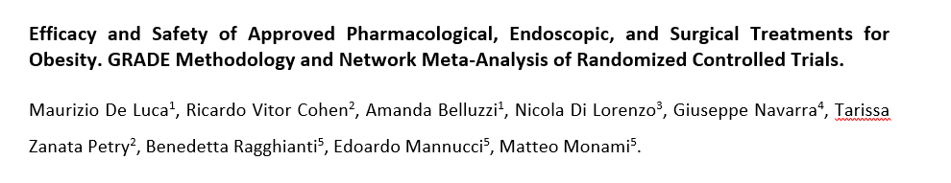
SICOB (MBS and Endobariatric) Guidelines (new update) and IFSO position statements
De Luca et al., manuscript submitted
Notes:
Per rendersi meglio conto dell’importanza dei farmaci, multimodal eccvi faccio vedere

Slide 12
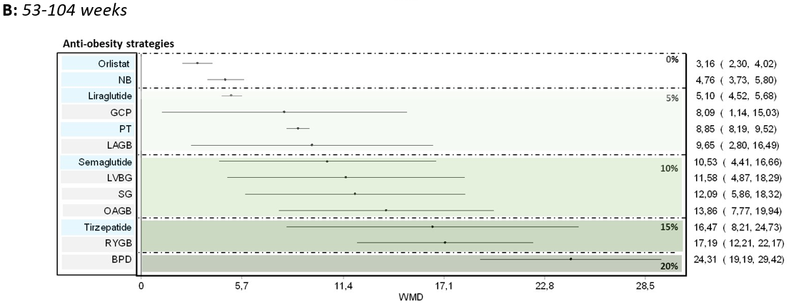
Total Body Weight Loss, %

Slide 13
Grazie

